Slide 1

ROS Cameras Controller
Ugnius Malukas @ugnelis

Slide 2
Connect and manage IP cameras in ROS environment
Project Idea

Slide 3
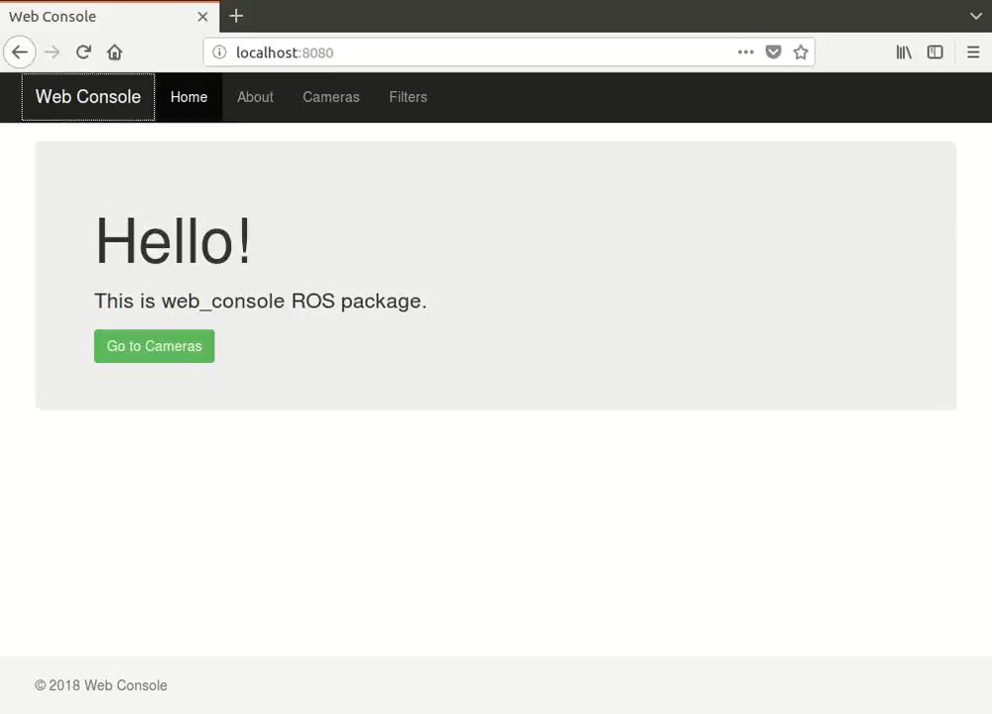

Slide 4
Architecture
image_processing_filters
web_console
use
commander
AngularJS app
use
Flask app
use
ROS service
video_stream_to_topic

Slide 5



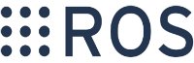

Technologies
ROS (kinetic) – base of the project.
OpenCV (3.1+) – restreaming and processing.
Flask – server of the front-end app.
AngularJS (1.7) – front-end app.
npm – front-end package manager.

Slide 6
What to add / fix? (1)
For commander:
More commands can be added,
Database.
For image_processing_filters:
Processing algorithms,
Recognition algorithms (i.e., face recognition).

Slide 7
What to add / fix? (2)
For video_stream_to_topic:
Support video strem formats (now is only *.mjpg).
For web_console:
Improve Front-End app.
For whole project:
Docker support.

Slide 8
Link
https://github.com/ugnelis/ros_cameras_controller

Slide 9
Thank you!

